Slide 1
JSP CRUD

Slide 2
JSP CRUD
In this module we will see below topics
JSP CRUD
JSP CRUD Example

Slide 3
JSP CRUD
CRUD - CREATE, READ, UPDATE and DELETE Operations
The common operations that are done for any web application are CRUD, which is CREATE, READ UPDATE & DELETE. In order to develop, learn web application, one should have a strong knowledge to handle these operations. And it is better if one do this operations using JSP instead of Servlets.
CREATE - Here, CREATE is to SAVE, the inputs which we initially want to store in the database from the User.
READ - As we CREATE or SAVE the details in the database, we want them to access in our USER INTERFACE. So for that we have to read the saved values (which we done earlier, i.e CREATE). This READ can be achieved through a SELECT query.
UPDATE - To UPDATE the detail that is SAVED in the database, you have to CREATE a dummy page of your MAIN page with same details which are mentioned in the registration or a particular page and whenever the user clicks on EDIT button or link we should redirect to that dummy page with the values which are requested by the user to EDIT & UPDATE.
DELETE - DELETE operation delete the particular record which is requested from the database.
Notes:
Note: If you want only the detail which is saved at that point then you have to make sure that you change the SELECT QUERY to the current processing USERID.

Slide 4
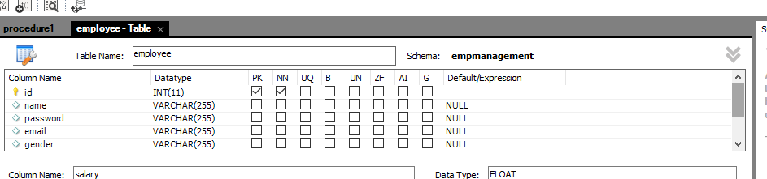
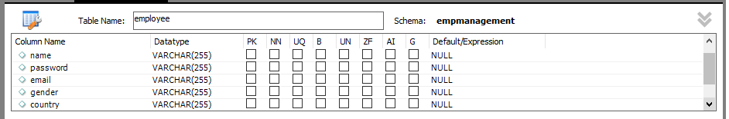
JSP CRUD Example Duration :40 min
Let us elaborate CRUD in JSP with example. First We create database in MySql ie. Empmanagement. And create the table employee with below column names.

Slide 5
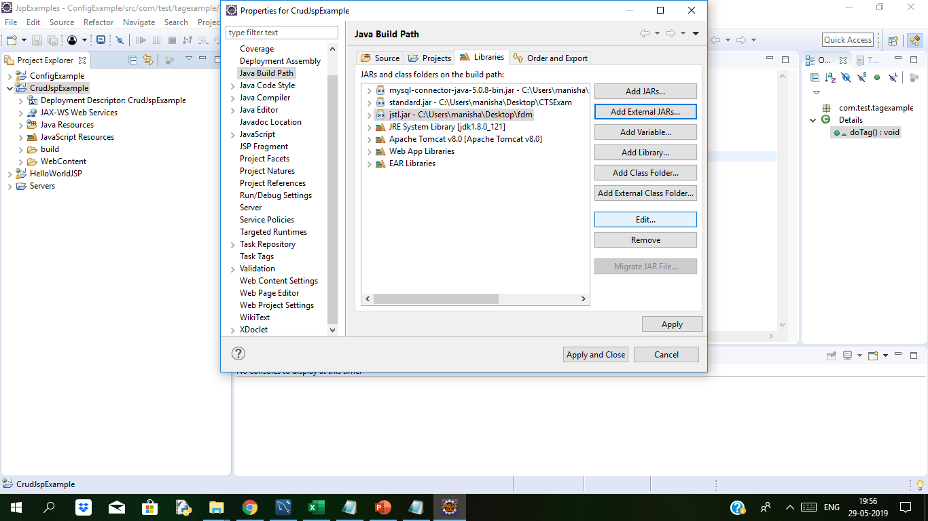
JSP CRUD Example Duration : 60 min
Now we create a dynamic web project in eclipse. After creating web project we will add mysql connector.jar file and jstl.jar file to project class path.
Package com.test.bean;
public class UserBean {
private int id;
private String name, password, email, Gender, country;
private float salary;
public int getId() {
return id;
}
public void setId(int id) {
this.id = id;
}
public String getName() {
return name;
}
public void setName(String name) {
this.name = name;
}
public String getPassword() {
return password;
}
public void setPassword(String password) {
this.password = password;
}
public String getEmail() {
return email;
}
public void setEmail(String email) {
this.email = email;
}
public String getGender() {
return Gender;
}
public void setGender(String Gender) {
this.Gender = Gender;
}
public String getCountry() {
return country;
}
public void setCountry(String country) {
this.country = country;
}
public float getSalary() {
return salary;
}
public void setSalary(float salary) {
this.salary = salary;
}
}
Create UserBean.java file under com.test.bean folder
It has constructor,getter and setter method with the help of which user can get the data

Slide 6
JSP CRUD Example Contd…
Now we will create UserDAO under com.test.dao package. UserDao User Data Access Object. In this class we will write queries of Create,Read,Update and delete the data and pagination code also
UserDAO.java
Package com.test.dao;
import java.sql.Connection;
import java.sql.DriverManager;
import java.sql.PreparedStatement;
import java.sql.ResultSet;
import java.util.ArrayList;
import java.util.List;
public class UserDAO {
public static Connection getConnection() { Connection con = null;
try {
Class.forName("com.mysql.jdbc.Driver");
con = DriverManager.getConnection("jdbc:mysql://localhost:3306/demojsp", "root", "");
} catch (Exception e) {
System.out.println(e);
} return con; }
public static int save(UserBean u) {
int status = 0;
try {
Connection con = getConnection();
PreparedStatement ps = con.prepareStatement("insert into Employees(name,password,email,gender,country,salary) values(?,?,?,?,?,?)");
ps.setString(1, u.getName());
ps.setString(2, u.getPassword());
ps.setString(3, u.getEmail());
ps.setString(4, u.get Gender());
ps.setString(5, u.getCountry());
ps.setFloat(6, u.getSalary());
status = ps.executeUpdate();
} catch (Exception e) {
System.out.println(e);
}
return status;
}
public static int update(UserBean u) {
int status = 0;
try {
Connection con = getConnection();
PreparedStatement ps = con.prepareStatement("update Employees set name=?,password=?,email=?,gender=?,country=?,salary=? where id=?");
ps.setString(1, u.getName());
ps.setString(2, u.getPassword());
ps.setString(3, u.getEmail());
ps.setString(4, u.getGender());
ps.setString(5, u.getCountry());
ps.setFloat(6, u.getSalary());
ps.setInt(7, u.getId());
status = ps.executeUpdate();
} catch (Exception e) {
System.out.println(e);
}
return status;
}
public static int delete(UserBean u) {
int status = 0;
try {
Connection con = getConnection();
PreparedStatement ps = con.prepareStatement("delete from Employees where id=?");
ps.setInt(1, u.getId());
status = ps.executeUpdate();
} catch (Exception e) {
System.out.println(e);
}
return status;
}
public static List<UserBean> getAllRecords() {
List<UserBean> list = new ArrayList<UserBean>();
try {
Connection con = getConnection();
PreparedStatement ps = con.prepareStatement("select * from Employees");
ResultSet rs = ps.executeQuery();
while (rs.next()) {
UserBean u = new UserBean();
u.setId(rs.getInt("id"));
u.setName(rs.getString("name"));
u.setPassword(rs.getString("password"));
u.setEmail(rs.getString("email"));
u.setGender(rs.getString("gender"));
u.setCountry(rs.getString("country"));
u.setSalary(rs.getFloat("salary"));
list.add(u);
}
} catch (Exception e) {
System.out.println(e); }
return list;
}

Slide 7
JSP CRUD Example contd..
public static List<UserBean> getRecords(int start, int total) {
List<UserBean> list = new ArrayList<UserBean>();
try {
Connection con = getConnection();
PreparedStatement ps = con.prepareStatement(
"select * from Employees limit " + (start - 1) + "," + total);
ResultSet rs = ps.executeQuery();
while (rs.next()) {
UserBean e = new UserBean();
e.setId(rs.getInt(1));
e.setName(rs.getString(2));
e.setSalary(rs.getFloat(7));
list.add(e);
}
con.close();
} catch (Exception e) {
System.out.println(e);
}
return list;
}
}
UserDAO.java contd…
public static UserBean getRecordById(int id) {
UserBean u = null;
try {
Connection con = getConnection();
PreparedStatement ps = con.prepareStatement("select * from Employees where id=?");
ps.setInt(1, id);
ResultSet rs = ps.executeQuery();
while (rs.next()) {
u = new UserBean();
u.setId(rs.getInt("id"));
u.setName(rs.getString("name"));
u.setPassword(rs.getString("password"));
u.setEmail(rs.getString("email"));
u.setGender(rs.getString("gender"));
u.setCountry(rs.getString("country"));
u.setSalary(rs.getFloat("salary"));
}
} catch (Exception e) {
System.out.println(e);
}
return u;
}

Slide 8
JSP CRUD Example contd..
header.html
<html>
<head>
<meta http-equiv="Content-Type" content="text/html; charset=utf-8" />
<style>
#navigation ul li{
display: inline-block;
padding: 0px 5px;
}
#navigation ul li a{
color:#fff;
text-decoration: none;
}
#navigation {
background: #4062b7;
padding: 3px
}
</style>
</head>
<body bgcolor="grey">
<div id="header">
<div class="shell">
<div id="navigation">
<ul>
<li><a href="index.jsp" class="active">Home</a></li>
<li><a href="paginationPage.jsp?page=1">Pagination</a></li>
<li><a href="viewUsers.jsp">View Employees</a></li>
<li><a href="addUserForm.jsp">Add Employees</a></li>
</ul>
</div>
</div>
</div>
</body>
</html>

Slide 9
JSP CRUD Example contd..
index.jsp(Launch Page)
<%@page language="java" contentType="text/html" pageEncoding="UTF-8"%>
<!DOCTYPE html>
<html>
<head>
<meta http-equiv="Content-Type" content="text/html; charset=UTF-8">
<title> Welcome Page</title>
</head>
<body>
<%@ include file="header.html" %> <br>
<a href="addUserForm.jsp">Add User</a>
<a href="viewUsers.jsp">View Users</a>
</body>
</html>
adduserForm.jsp (this will include userForm.html add redirect to addUser.jsp)
<%@ page language="java" contentType="text/html; charset=ISO-8859-1"
pageEncoding="ISO-8859-1"%>
<!DOCTYPE html>
<html>
<head>
<meta http-equiv="Content-Type" content="text/html; charset=ISO-8859-1">
<title> Registration</title>
</head>
<body>
<%@ include file="header.html" %> <br>
<jsp:include page="userForm.html"></jsp:include>
</body>
</html>

Slide 10
JSP CRUD Example contd..
userForm.html this form will register the employee and redirect to addUser.jsp
<h1>Add New Employee</h1>
<form action="addUser.jsp" method="post">
<table>
<tr><td>Name:</td><td><input type="text" name="name"/></td></tr>
<tr><td>Password:</td><td><input type="password" name="password"/></td></tr>
<tr><td>Email:</td><td><input type="email" name="email"/></td></tr>
<tr><td>Salary:</td><td><input type="number" step="0.01" name="salary"/></td></tr>
<tr><td>Sex:</td><td><input type="radio" name="sex" value="male"/>Male <input type="radio" name="sex" value="female"/>Female </td></tr>
<tr><td>Country:</td><td>
<select name="country" style="width:155px">
<option>India</option>
<option>New Zealand</option>
<option>Srilanka</option>
<option>Other</option>
</select>
</td></tr>
<tr><td colspan="2"><input type="submit" value="Add User"/></td></tr>
</table>
</form>
(This will add user and in this we have called save method of UserDAO)
addUser.jsp
<%@page import=“com.test.dao.UserDAO"%>
<jsp:useBean id="u" class=“com.test.bean.UserBean"></jsp:useBean>
<jsp:setProperty property="*" name="u"/>
<%
int i=UserDAO.save(u);
if(i>0){
response.sendRedirect("AddUserSuccess.jsp");
}else{
response.sendRedirect("errorPage.jsp");
}
%>

Slide 11
JSP CRUD Example contd..
AddUserSuccess.jsp , this page will display after successful registration
<!DOCTYPE html>
<html>
<head>
<meta http-equiv="Content-Type" content="text/html; charset=ISO-8859-1">
<title>Add User Success</title>
</head>
<body>
<%@ include file="header.html" %>
<p>Record successfully saved!</p>
<jsp:include page="userForm.html"></jsp:include>
</body>
</html>
errorPage.jsp if any exception or error will happen during registration this page will be displayed
<!DOCTYPE html>
<html>
<head>
<meta http-equiv="Content-Type" content="text/html; charset=ISO-8859-1">
<title>Add User Success</title>
</head>
<body bgcolor>
<%@ include file="header.html" %>
<p>Sorry, an error occurred!</p>
<jsp:include page="userForm.html"></jsp:include>
</body>
</html>

Slide 12
JSP CRUD Example contd..
viewUsers.jsp To display the data of all Employees
<%@page import="com.test.bean.UserBean"%>
<!DOCTYPE html>
<html>
<head>
<meta http-equiv="Content-Type" content="text/html; charset=ISO-8859-1">
<title>View Users</title>
</head>
<body bgcolor="grey">
<%@ include file="header.html" %> <br>
<%@page import=“com.test.dao.UserDAO, com.test.bean.UserBean,java.util.*"%>
<%@ taglib uri="http://java.sun.com/jsp/jstl/core" prefix="c"%>
<h1>Users List</h1>
<%
List<UserBean> list = UserDAO.getAllRecords();
request.setAttribute("list", list);
%>
<table border="1" width="90%">
<tr><th>Id</th><th>Name</th><th>Password</th><th>Email</th><th>Sex</th><th>Country</th><th>Salary</th><th>Edit</th><th>Delete</th></tr>
<c:forEach items="${list}" var="u">
<tr><td>${u.getId()}</td><td>${u.getName()}</td><td>${u.getPassword()}</td><td>${u.getEmail()}</td><td>${u.getSex()}</td><td>${u.getCountry()}</td><td>${u.getSalary()}</td><td><a href="updateForm.jsp?id=${u.getId()}">Edit</a></td><td><a href="DeleteUser.jsp?id=${u.getId()}">Delete</a></td></tr>
</c:forEach>
</table>
<br/><a href="addUserForm.jsp">Add New User</a>
</body>
</html>

Slide 13
JSP CRUD Example contd..
updateForm.jsp for updating the details of Employee
<!DOCTYPE html>
<html>
<head>
<meta http-equiv="Content-Type" content="text/html; charset=ISO-8859-1">
<title>Edit Form</title>
</head>
<body>
<%@ include file="header.html" %> <br>
<%@page import="w3adda.*"%>
<%
String id = request.getParameter("id");
UserBean u = UserDAO.getRecordById(Integer.parseInt(id));
%>
<h1>Edit Form</h1>
<form action="UpdateUser.jsp" method="post">
<input type="hidden" name="id" value="<%=u.getId()%>"/>
<table>
<tr><td>Name:</td><td><input type="text" name="name" value="<%= u.getName()%>"/></td></tr>
<tr><td>Password:</td><td><input type="password" name="password" value="<%= u.getPassword()%>"/></td></tr>
<tr><td>Email:</td><td><input type="email" name="email" value="<%= u.getEmail()%>"/></td></tr>
<tr><td>Salary:</td><td><input type="number" step="0.01" name="salary" value="<%= u.getSalary()%>"/></td></tr>
<tr><td>Gender</td><td><input type="radio" name="sex" value="male"/>Male <input type="radio" name="sex" value="female"/>Female </td></tr>
<tr><td>Country:</td><td>
<select name="country">
<option>India</option>
<option>New Zealand</option>
<option>Srilanka</option>
<option>Other</option>
</select>
</td></tr>
<tr><td colspan="2"><input type="submit" value="Edit User"/></td></tr>
</table>
</form>
</body>
</html>

Slide 14
JSP CRUD Example contd..
updateUser.jsp updating specific user.
<%@page import=“com.test.dao.UserDAO"%>
<jsp:useBean id="u" class=“com.test.bean.UserBean"></jsp:useBean>
<jsp:setProperty property="*" name="u"/>
<%
int i=UserDAO.update(u);
response.sendRedirect("viewUsers.jsp");
%>
deleteUser,jsp
Deleting specific user
<%@page import=“com.test.dao.UserDAO"%>
<jsp:useBean id="u" class=“com.test.bean.UserBean"></jsp:useBean>
<jsp:setProperty property="*" name="u"/>
<%
UserDAO.delete(u);
response.sendRedirect("viewUsers.jsp");
%>

Slide 15
JSP CRUD Example contd..
paginationPage.jsp
<%@ page import="java.util.*,com.test.bean.UserBean, com.test.dao.UserDAO"%>
<%@ include file="header.html" %> <br>
<%
String spageid = request.getParameter("page");
int pageid = Integer.parseInt(spageid);
int total = 2;
if (pageid == 1) {
} else {
pageid = pageid - 1;
pageid = pageid * total + 1;
}
List<UserBean> list = UserDAO.getRecords(pageid, total);
out.print("<h1>Page No: " + spageid + "</h1>");
out.print("<table border='1' cellpadding='4' width='60%'>");
out.print("<tr><th>Id</th><th>Name</th><th>Salary</th>");
for (UserBean e : list) {
out.print("<tr><td>"+e.getId()+"</td><td>"+e.getName() +"</td><td>"+e.getSalary ()+"</td></tr> ");
}
out.print("</table>");
%>
<a href="paginationPage.jsp?page=1">1</a>
<a href="paginationPage.jsp?page=2">2</a>
<a href="paginationPage.jsp?page=3">3</a>
deleteUser,jsp
Deleting specific user
<%@page import=“com.test.dao.UserDAO"%>
<jsp:useBean id="u" class=“com.test.bean.UserBean"></jsp:useBean>
<jsp:setProperty property="*" name="u"/>
<%
UserDAO.delete(u);
response.sendRedirect("viewUsers.jsp");
%>

Slide 16
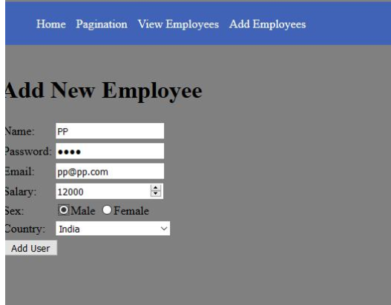
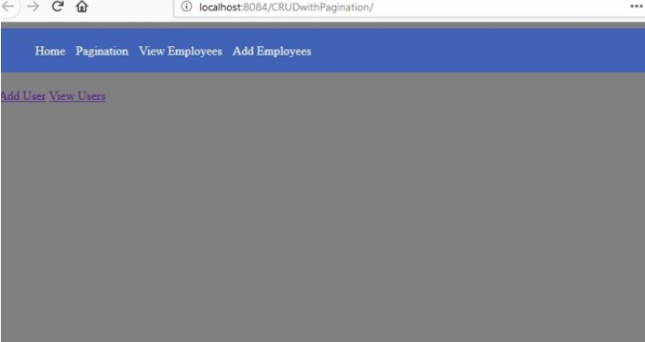
JSP CRUD Example contd..
After running this project we get following screen/Home page on browser.
When we click on add Employee or addUser button we get following form

Slide 17
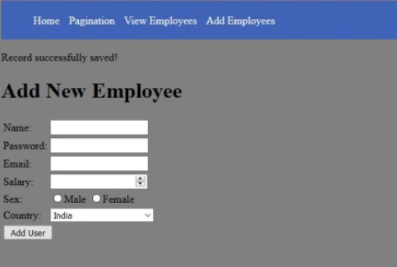
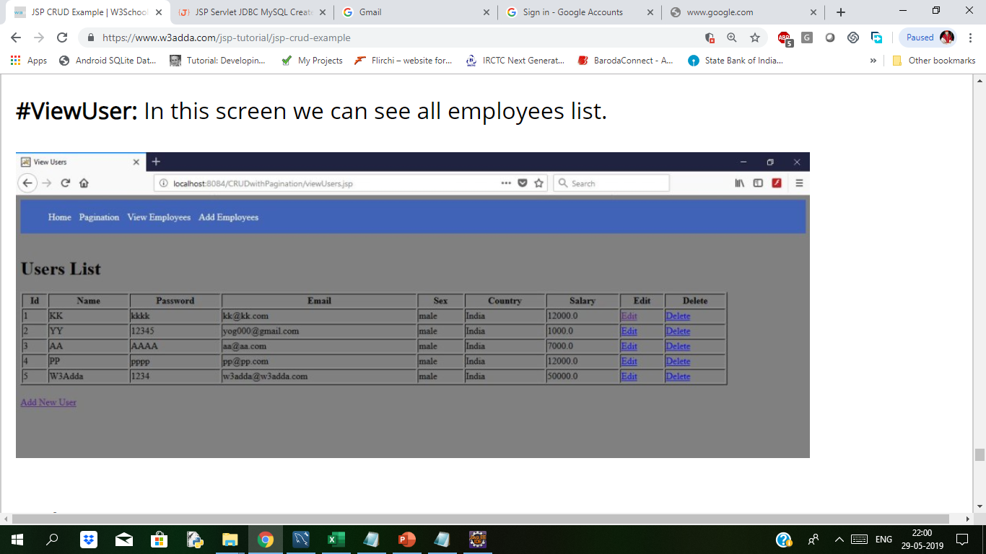
JSP CRUD Example contd..
After registering successfully AddUserSuccess page.
View or list all employees viewUser

Slide 18
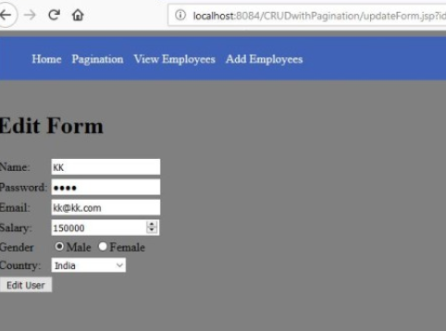
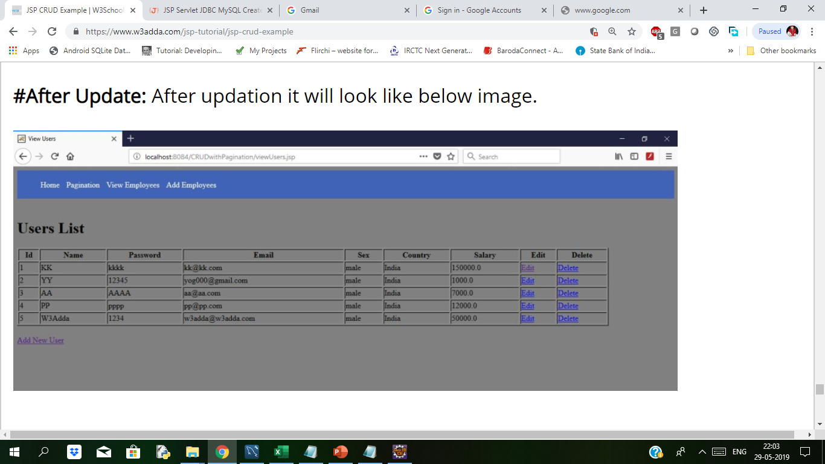
JSP CRUD Example contd..
For Editing below form will display
After Updating below form will display

Slide 19
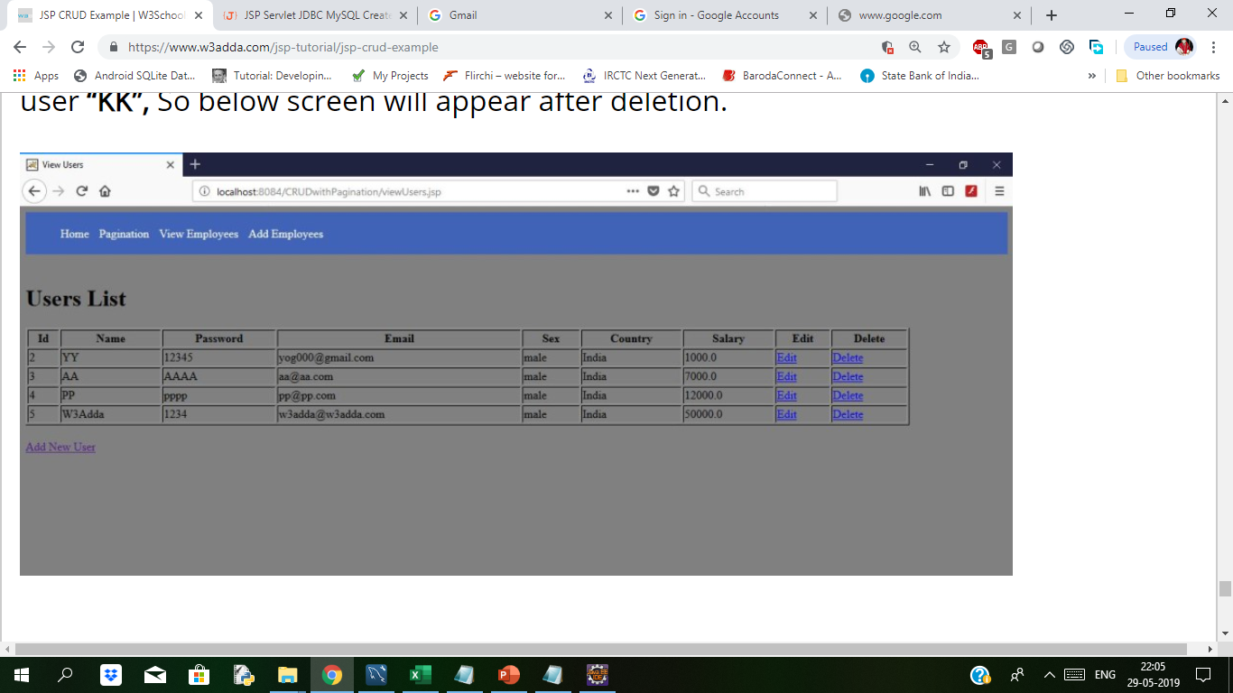
JSP CRUD Example contd..
After Deleting the user/employee

Slide 20
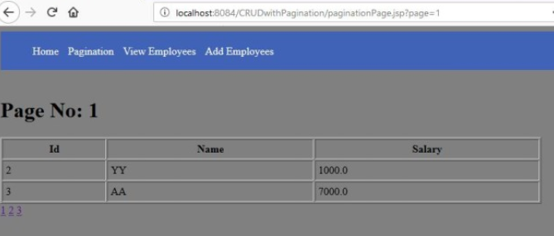
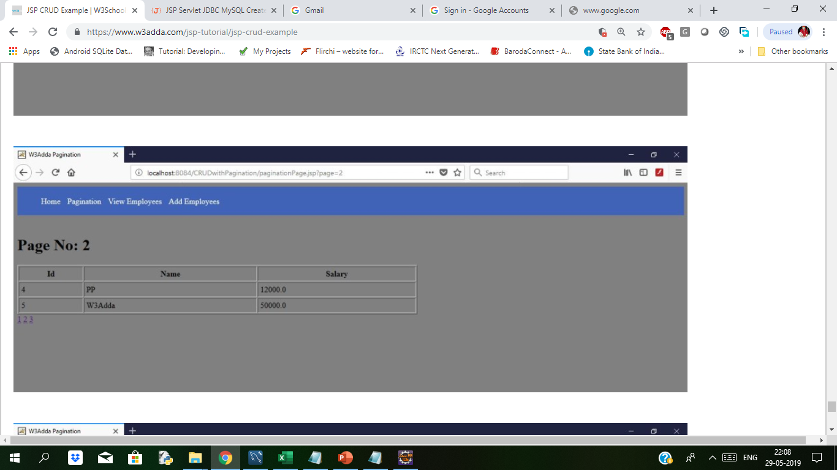
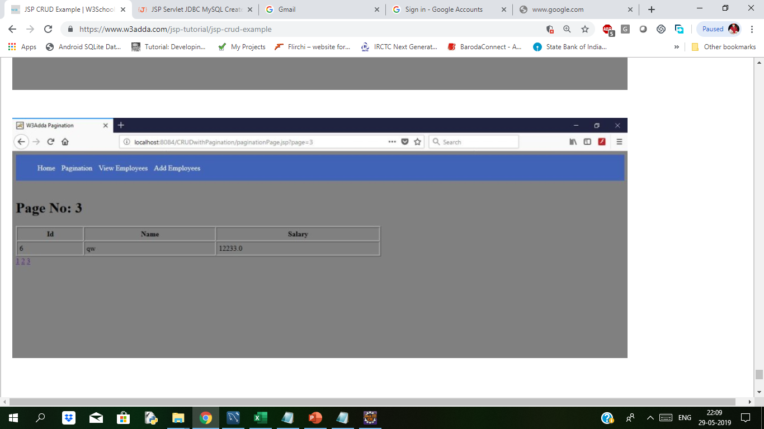
JSP CRUD Example contd..
For Pagination below screens will display on browser
Notes:
This was the example of Crud alongwith pagination.

Slide 21

Thank You

